Slide 1
Biological Databases
Notes:
Slide 1: Biological Databases – where to find DNA, RNA, and Protein data for analysis

Slide 2
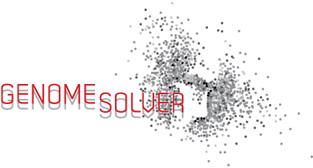
Learning Goals
Participants will become familiar with the human microbiome project
Participants will know how to access the human microbiome project and other biological databases
Participants will know the utility of accession numbers
Participants will know how to download sequences from databases
Notes:
Slide 2: The learning goals for this slide deck are
1) To become familiar with the human microbiome project which has made a major push to sequence genomes of prokaryotes found in humans
2) To learn how to access the biological databases where all the sequences are housed
3) To learn about the utility of accession numbers which serve as unique identifiers for these sequences and
4) To learn how to download sequences of interest once you find them

Slide 3
Genome Sequencing: Faster and Cheaper
Notes:
Slide 3: On this slide, time is on the x axis and on the y axis is DNA sequence in kilobases per day per machine. Clearly the rate of sequencing has been growing exponentially while simultaneously the cost of sequencing is going down. So sequence data is made available faster and cheaper than ever before, and this has led to a bottleneck for analysis of these data. Here’s an opportunity for students to get involved in sequence analysis.

Slide 4
The Human Microbiome
Definitions:
Microbiome: Aggregate of all microbial genomes
Microbiota: Individual bacterial species in the biome
Over 100 trillion organisms (10¹⁴)
Over 500 species identified so far (70 divisions)
90% of the cells in our body are microbial!
Our microbial flora are an integral part of our genetic landscape and evolution
Notes:
Slide 4: A few definitions:
The microbiome is the aggregate of all microbial genomes in the sample that you are investigating. Microbiota refers to individual bacterial species in a specific biome. There are trillions of organisms out there, and out of these 500 species have been identified. In the human body majority of the cells are microbial - so you are made up of more microbial cells than human cells. We know that these microbes have remained in the human body for thousands of years so they must be an integral part of our evolution and must be performing some vital function, which we have not identified yet.

Slide 5
The Human Microbiome Project (HMP)
An effort through NIH to understand the diversity of microbes associated with different body sites in and on the human body
Initially funded for 5 years beginning in 2007
Data can be accessed at HMP DACC
hmpdacc.org/hmp
Second phase to understand the role of the microbiome in health and disease
Integrative Human Microbiome Project (iHMP)
hmpdacc.org/ihmp
Notes:
Slide 5: We’re now more than 10 years into the first investigations into the human microbiome. We’ve learned a lot, but there’s a lot still to uncover.

Slide 6
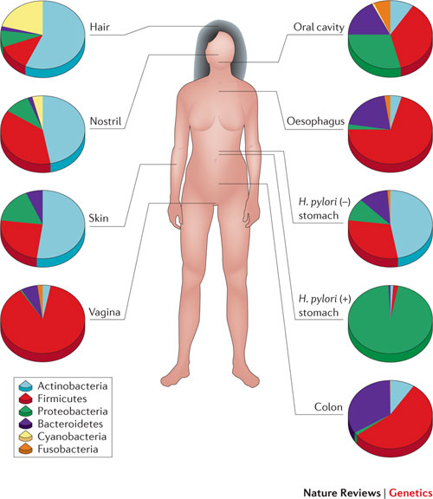
Lessons Thus Far from the Human Microbiome Project
Body sites have distinct signatures
your gut microbiome is more like someone else’s gut microbiome than it is to your skin microbiome
Microbiota contribute metabolic functions
vitamins, SCFAs, etc.
Notes:
Slide 6: The Human Microbiome Project (HMP) was started in 2008 as an initiative by the NIH. HMP researchers sequenced the microbes in different regions of the human body and now we can see those results. If you see the figure and look at the pie charts, they are showing the abundance of different phyla of bacteria on different regions of the human body. The next stage of the project is to start identifying the function that these microbes are playing within the human body. There is already evidence that they are involved in certain metabolic functions like production of vitamins and short chain fatty acids. But this research is still in its infancy stage and a there area a lot of things still to be uncovered.

Slide 7
Other Microbiome Projects
The Earth Microbiome Project
earthmicrobiome.org
“a systematic attempt to characterize global microbial taxonomic and functional diversity for the benefit of the planet and humankind”
American Gut Project
americangut.org
Human Oral Microbiome Database (HOMD)
www.homd.org
Notes:
Slide 7: There are a variety of other microbiome projects too, some associated with human health, but others are attempted to understand the wealth of microbes in many different environments.

Slide 8
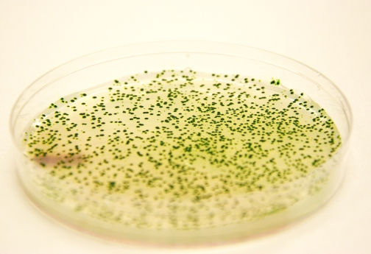
A Discrepancy Discovered Over the Years…
The
Great
Plate-Count
Anomaly
Exploring prokaryotic diversity in the genomic era
P. Hugenholtz, Genome Biology (2002)
Notes:
Slide 8: We know now there are trillions of microbes out there; scientists have realized that there is a discrepancy between the number that we can grow in lab conditions and the ones we can see under the microscope in a given sample (and that we can now detect by sequencing). This is termed “The Great Plate Count Anomaly.” Fewer than 1% of known organisms can be grown in the lab. So there are many organisms we are missing.
In 1932, Razumov discovered a discrepancy between the viable plate count and the direct microscopic count of bacteria¹
In 1949, Sergei Winogradsky noted that many bacteria are unable to grow in laboratory conditions²
In 1985, pointed to Razumov’s discrepancy and called it the “Great Plate Count Anomaly”³
By David Relman’s estimate, 99.6% of the species in the human microbiota cannot be characterized by culturing techniques⁴
¹ Razumov AS 1932 Mikrobiologija 1, 131
² Grice EA et al. 2008. Genome Res. 18, 1043
³ Staley JT et al. 1985. Annu. Rev. Microb. 39, 321
⁴ Relman DA 1998. Emerg Infect.Dis. 4, 32

Slide 9
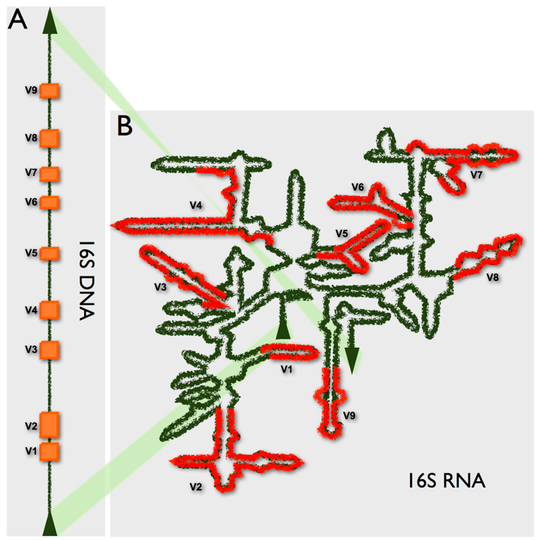
Metagenomics
SO - only ~1% of bacteria are culturable
how to “find” the others?
Metagenomics
sequence16S rRNA genes
yields information about types of bacteria and their abundance in a population
Notes:
Slide 9: So how do we identify aspects of this hidden diversity? Because of recent changes in technology, there is a newly emergent field called metagenomics. One way that is used frequently is to amplify a portion of the 16S rRNA genes in an environmental sample and then sequence the individual pieces of DNA. The type and number of sequences provides information about the types of bacteria and their abundance within an population.

Slide 10
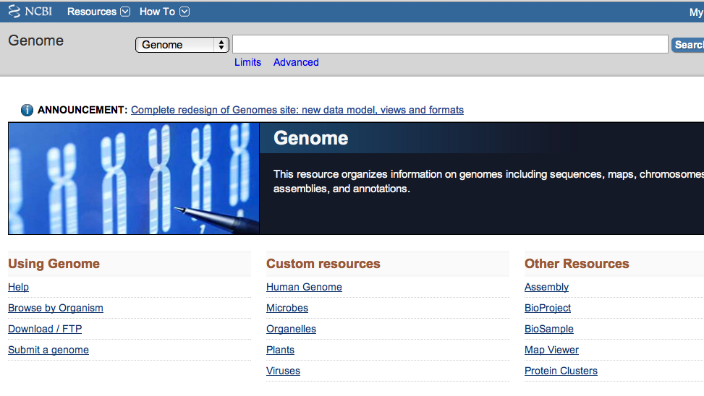
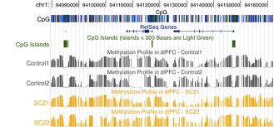
Biological Databases
Databases are data repositories that include all or most of the sequence data of one or more organisms
Databases also contain informational data that describes features of the sequence or additional biological properties of the organism (annotations)
Databases include a web-based visual interface - “genome browser”
Schattner P. (2008). Genome Browsers and databases (Cambridge Univ. Press, NY), pp 1-21
Notes:
Slide 10: Now: how do we access genomic data or 16S data to begin our analyses? Such data are stored in a variety of sequence databases, data repositories that include sequences of one or more organisms. They include additional details that describe important data features including certain biological properties called annotations, which we will talk about more in the next slide deck. These databases sometimes include certain genome browsers, which make it easy to visualize the sequence data and associated features.

Slide 11
Nucleotide Sequence Repositories
GenBank: part of NCBI
-National Center for Biotechnology information
www.ncbi.nlm.nih.gov
Notes:
Slide 11: There are various databases where nucleotide and protein sequences are stored. Genbank is the American initiative by the National Center for Biotechnology Information (NCBI).

Slide 12
Nucleotide Sequence Repositories
GenBank: part of NCBI
-National Center for Biotechnology information
www.ncbi.nlm.nih.gov
EMBL-EBI
-European Bioinformatics Institute
www.ebi.ac.uk
Notes:
Slide 12: There is a similar European database called EMBL, an initiative by the European Bioinformatics Institute.

Slide 13
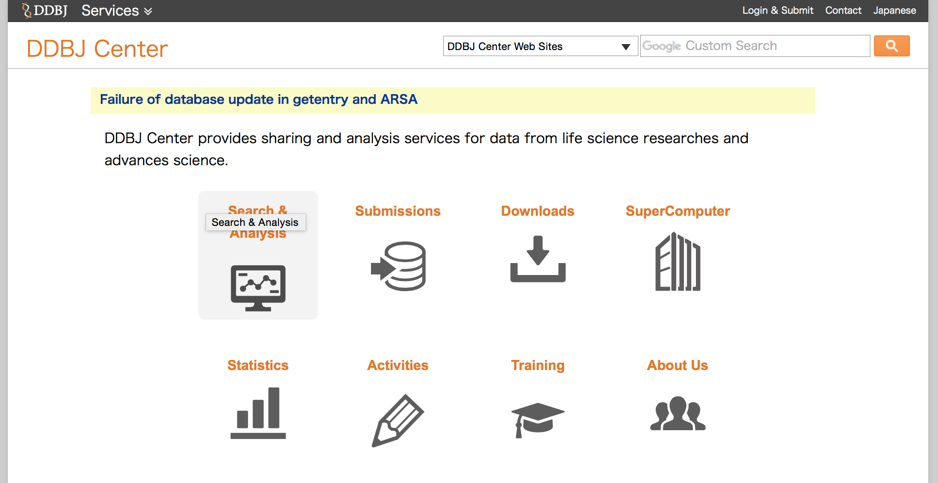
Nucleotide Sequence Repositories
GenBank: part of NCBI
-National Center for Biotechnology information
www.ncbi.nlm.nih.gov
EMBL-EBI
-European Bioinformatics Institute
www.ebi.ac.uk
DDBJ
-DNA Data Bank of Japan
www.ddbj.nig.ac.jp
Sequence information is same, different formats, tools and interfaces
Apweiler R. (2005). Sequence databases in Baxevanis AD & Ouelette B, eds., Bioinformatics: A practical guide to the analysis of genes and proteins (Wiley Press, NJ). 3rd Ed.
Notes:
Slide 13: Also, there is the DNA Databank of Japan (DDBJ). On all these databases, the sequence information is the same, they use different formats and slightly different interfaces.

Slide 14
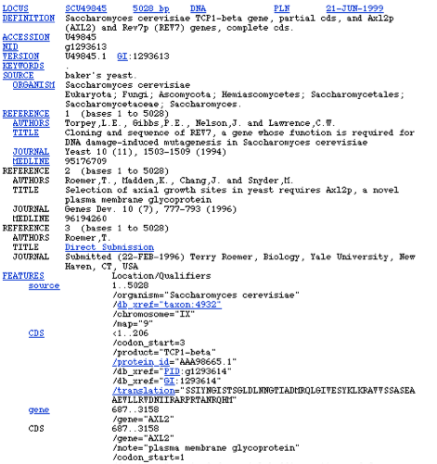
Nucleotide Database at NCBI: GenBank
GenBank contains all DNA sequences described in the scientific literature or collected in publicly funded research
Entries in GenBank are flat files, as each entry has a record for organism, date of entry, authors associated with the entry and accession numbers
Apweiler R. (2005). Sequence databases in Baxevanis AD & Ouelette B, eds., Bioinformatics: A practical guide to the analysis of genes and proteins (Wiley Press, NJ).3rd Ed.
Notes:
Slide 14: For our purposes we will be focusing on GenBank. The entries in GenBank are referred to as “flat files” – here’s a screenshot of one entry. This flat file contains information related to the sequence like the date of entry, researchers who made the submission, and most importantly a unique accession number.

Slide 15
Accession Numbers
In a database an essential feature of a DNA/protein sequence is the alphanumeric identifiers they are tagged with
These accession numbers are a string of 4-10 alphanumeric characters that are associated with a sequence record
Accession numbers are unique identifiers and can be used to search databases
Pevsner J. (2009). Bioinformatics and Functional Genomics (Wiley Press, NJ). 2nd Ed: pp 13-47
Notes:
Slide 15: The accession number is a unique identifier (a string of 4-10 alphanumeric characters) that can be used to search for a sequence of interest. One thing to pay attention to is while each unique accession number points to a unique sequence, a given sequence may have more than one accession number.

Slide 16
Accession Numbers
Notes:
Slide 16: On this flat file, the accession number is circled in red. We will learn more about its utility when we do the associated exercise at the end of this slide deck.

Slide 17
Comprehensive Protein Sequence Database: UniProt
UniProt is a high-quality, freely accessible protein database with associated functional information
http://www.uniprot.org/
The UniProt Consortium consists of the following databases :
PIR-PSD
-Protein Information Resource
http://pir.georgetown.edu/
SWISS-PROT
-Swiss Institute of Bioinformatics
TrEMBL
-Translated EMBL: translation of all coding sequences
present in the EMBL nucleotide database
UniProt Consortium. (2012). Nucleic Acids Res. 40: D71-75
Notes:
Slide 17: GenBank has both nucleotide and protein databases, but there are some other protein databases that are useful.
One of the best databases for proteins is UniProt. The UniProt consortium consists of three databases: 1) Protein Information Database that is housed in Georgetown 2) Swiss-Prot and 3)Tremble. Swiss-Prot and Tremble are both providing functional information to the protein entries. Swiss-Prot is manually curated whereas Tremble is a computer-annotated supplement to Swiss-Prot.

Slide 18
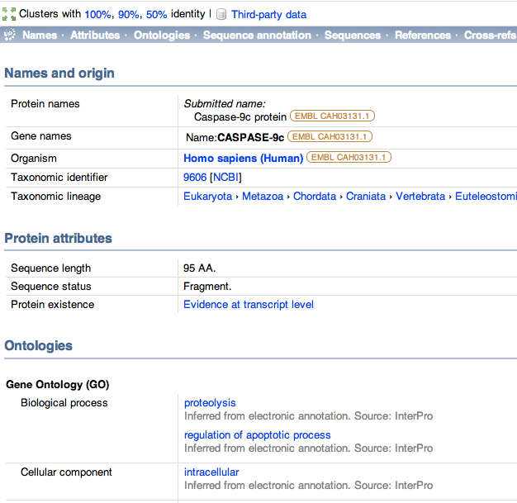
UniProt Entries - Caspase 9 (Q6EV95)
Information on organism
Sequence information
Annotations
Notes:
Slide 18: Just like NCBI, data in UniProt are organized in flat files, which give similar information such as the name and origin of the entry, sequence information, and annotations of those sequences.

Slide 19
Integrated Microbial Genomes (IMG) Database - Source of Genomes
https://img.jgi.doe.gov/cgi-bin/edu/main.cgi
Notes:
Slide 19: If you are working with prokaryotic data, which we do in Genome Solver, there is a specific database called the Integrated Microbial Genome Database from the Joint Genome Institute, which is very useful. In the next few slides, we’ll talk about some of the features.

Slide 20
Access the IMG Genome Browser
Genome search for
organism of interest
Access the FASTA
sequence
Download complete genome
20
Notes:
Slide 20: Conceptual pipeline for accessing a prokaryotic genome.

Slide 21
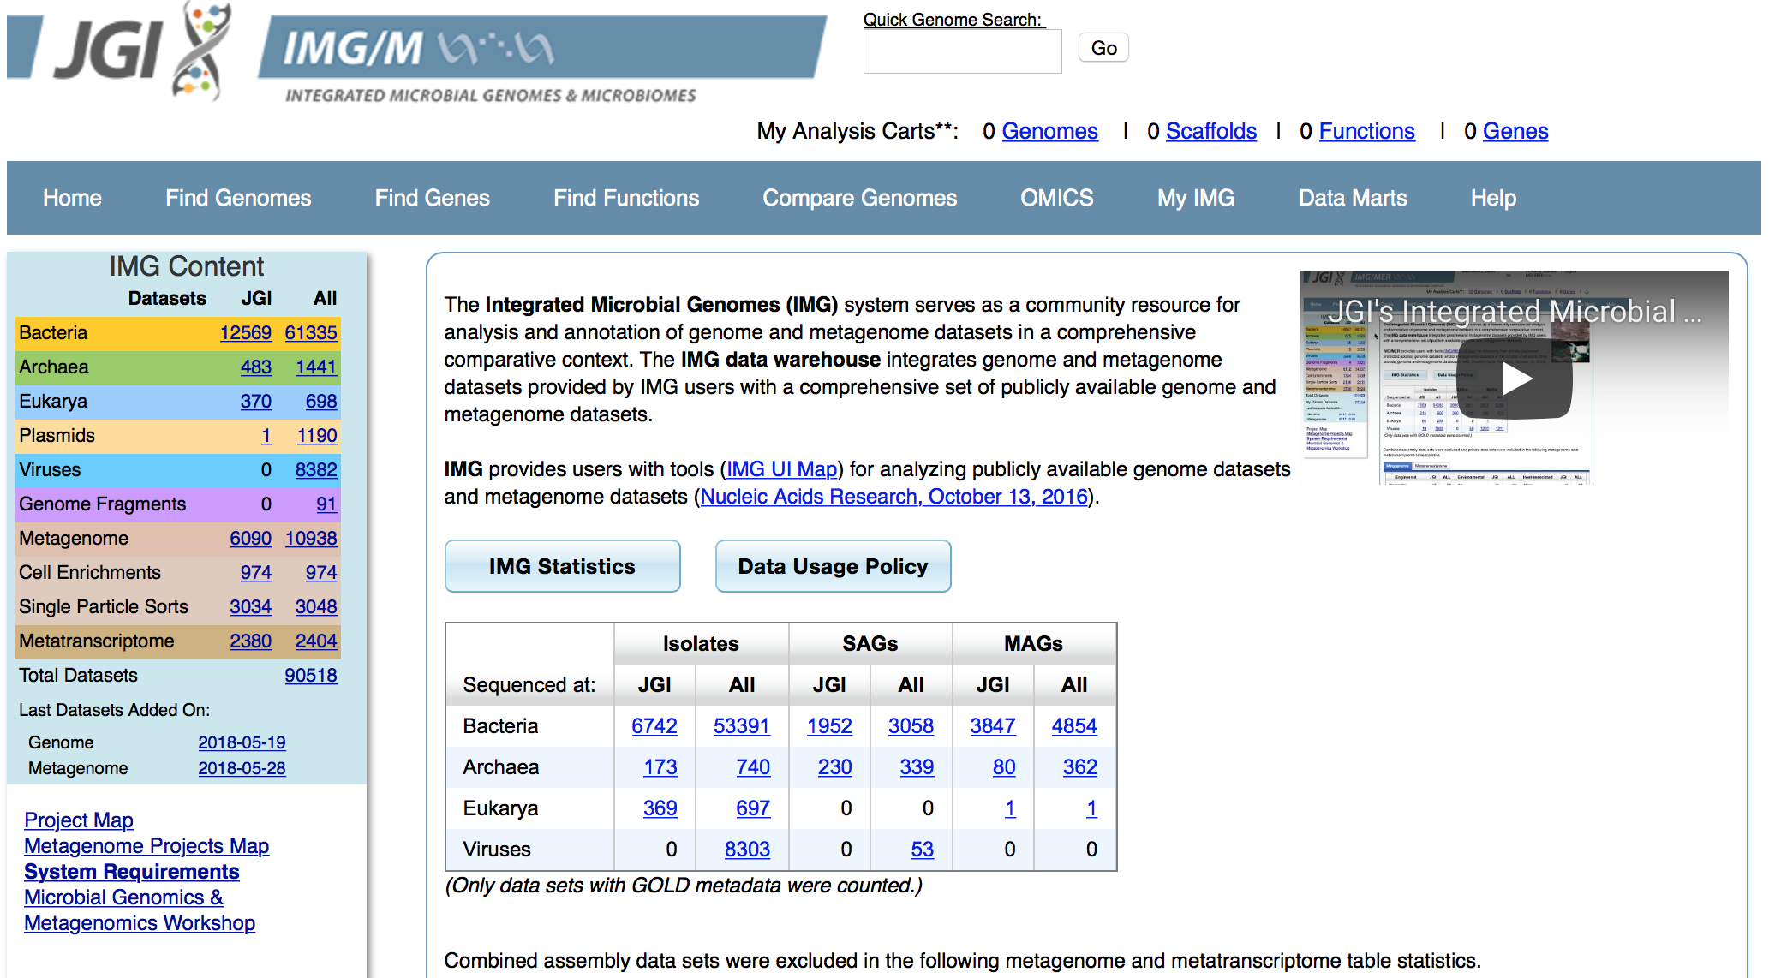
Integrated Microbial Genomes (IMG) Database - Source of Genomes
https://img.jgi.doe.gov/cgi-bin/w/main.cgi
Under the pull down tab Find Genomes (see red bar above), click on Genome Browser
Notes:
Slide 21: In the IMG database you can search for an organism of interest - click on the “Find Genomes” tab and input the name of the organism you are searching for. It provides you a list of matching entries. Clicking on an entry gives you all the associated information and also gives you access to the sequence in the form of a FASTA file (more about this in the next slide). IMG also has its own built-in genome browser.

Slide 22
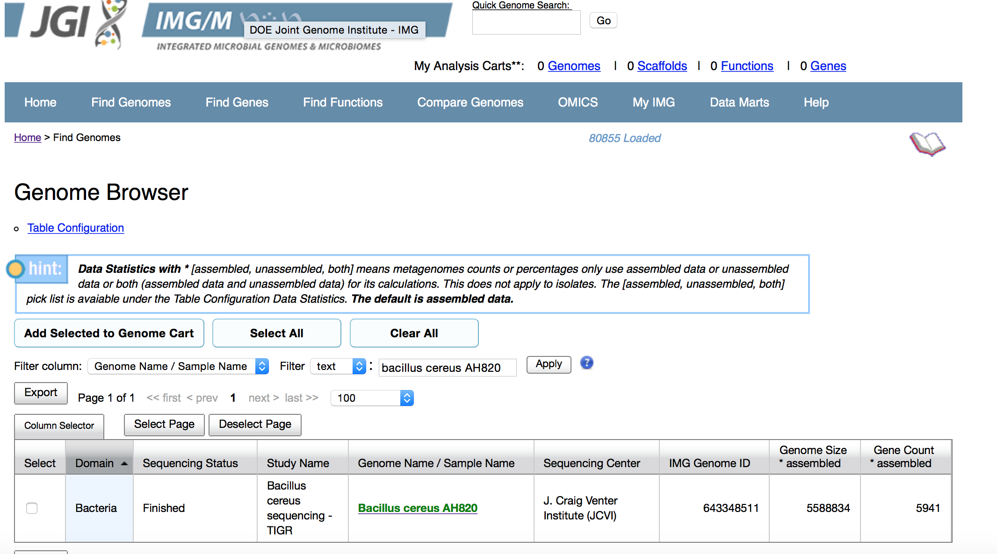
Accessing the IMG Database
click here
Use the filter column to select the filter “Genome Name” (red bar) and then enter the name of the genome in the search bar (red circle)
Alternately enter the name of the organism in the “Quick Genome Search” bar at the top
(yellow circle)
Notes:
Slide 22: Alternatively, you can type in the organism of interest under “Genome Browser.” As with most databases and browsers, there is more than one way to get to the information you’re looking for, so spending some time getting familiar with the different types of navigation will help you become more comfortable.

Slide 23
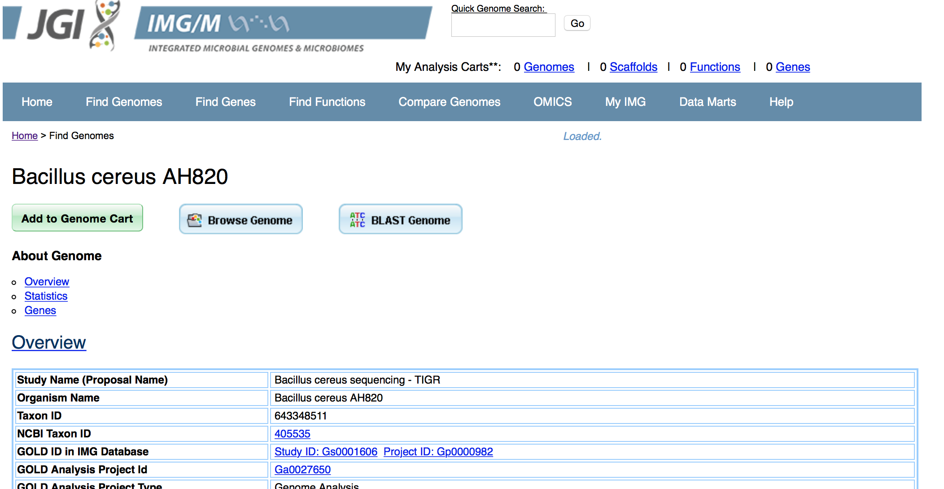
Accessing the IMG Database
Once you select your organism, click on Project ID and you will be directed in a few clicks to a page where you can download the FASTA sequences
Notes:
Slides 23-26: The next several slides show you one way to navigate through the IMG Database to get to sequence information.

Slide 24
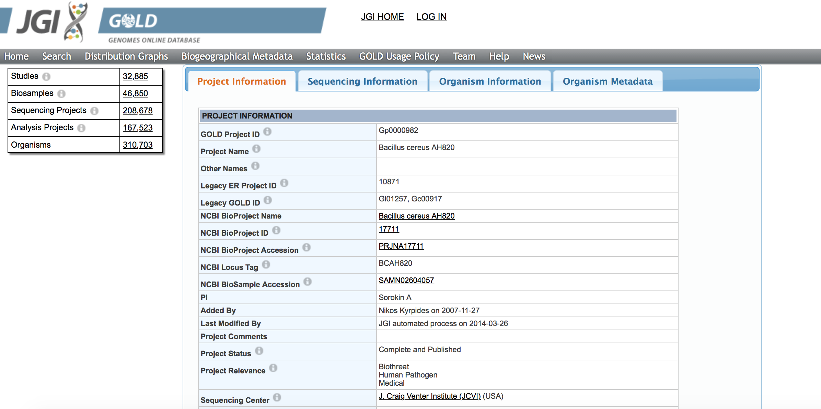
Accessing the Genome Sequence
Click on the NCBI BioProjec ID to be directed to a page where you can download the complete genome”

Slide 25
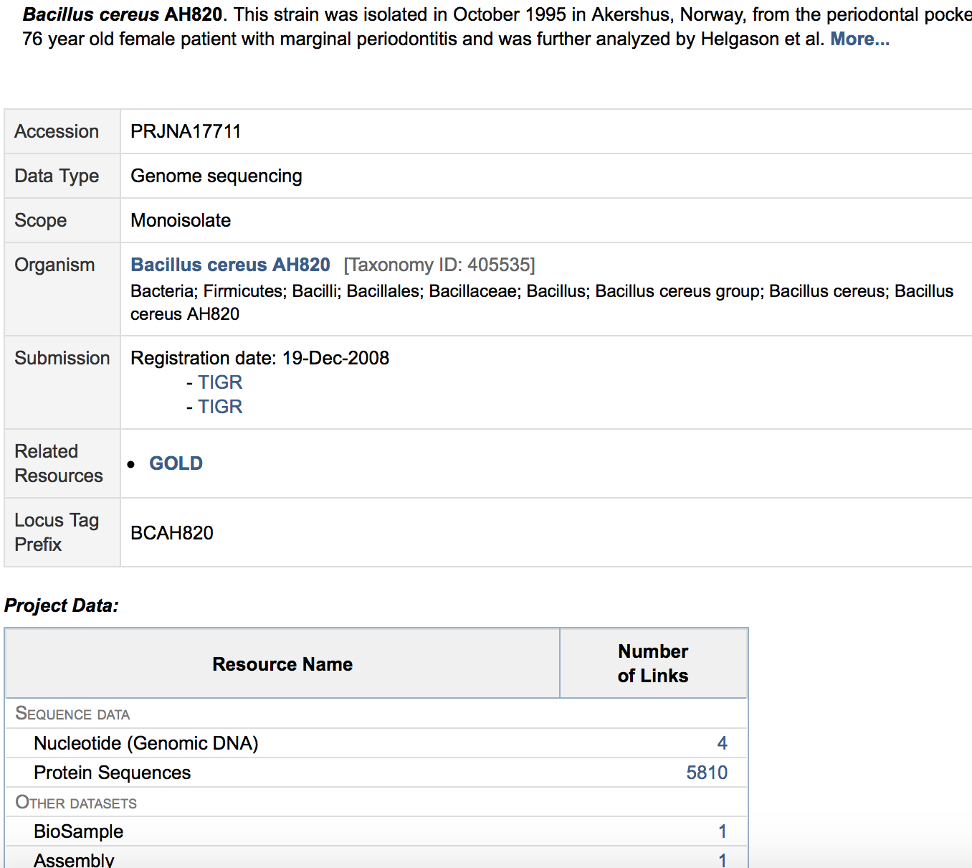
Accessing the Genome Sequence
This takes you to the nucleotide sequence at NCBI; there are 3 plasmids and 1 chromosomal sequence

Slide 26
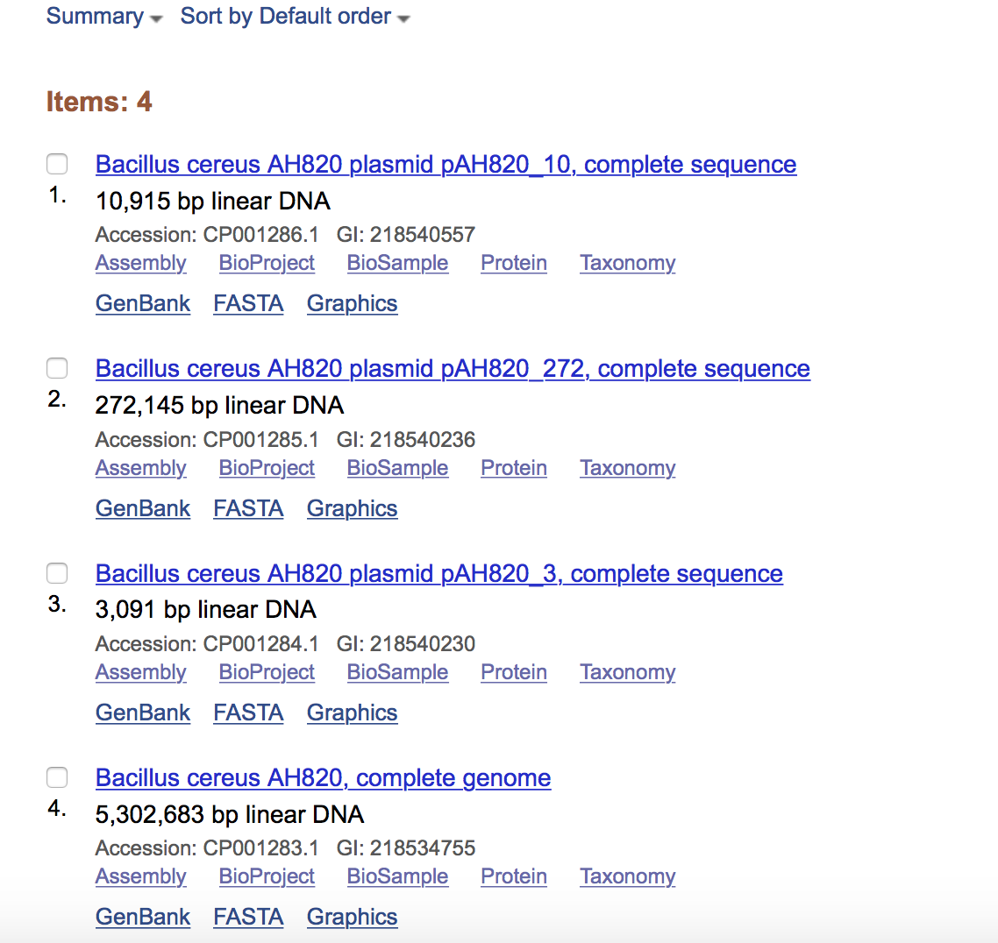
Accessing the Genome Sequence
Link to chromosomal sequence

Slide 27
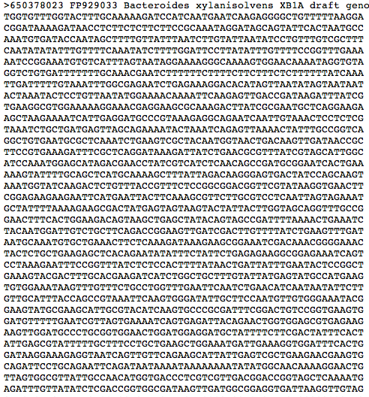
FASTA Format
Notes:
Slide 27: This slide shows FASTA format. When downloading sequences in FASTA format, the first line is the identifier and contains useful information (metadata) associated with that sequence (red oval). Most computer programs will “know” that the sequence starts on the second line (after a “return” at the end of the first line). So be careful that you are not manually changing the file in any way as it may lead to loss of sequence information.

Slide 28
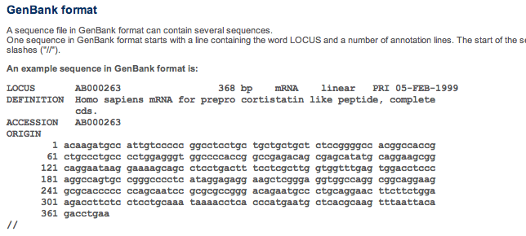
GenBank Format
Notes:
Slide 28: Similar to the FASTA format is GenBank format. It contains the same nucleotide information but here every line is numbered which makes it easier to look at a particular nucleotide base in the sequence.

Slide 29
Summary
Introduction to metagenomics
Biological databases
Accession numbers and how to use them
Notes:
Slide 29: To recap, in this slide deck we learned about metagenomics and its application in the Human Microbiome Project. We learned about different databases and got a brief introduction to browsers.
This slide deck should be followed by the Accession Number Exercise to get some practice navigating the different websites.
Next, we’ll turn to Part III – Annotation.

